Slide 1

Cyclistic Case Study
Muzammil Ahmed
Updated on 29.12.2021

Slide 2
Agenda
Background
Business case
Roadmap
Analysis
Data cleaning
Observation
Next steps

Slide 3
Background
Cyclistic is a bike sharing company
It has around 5800 bikes available in ~600 docking stations in Chicago
Cyclistic has a variety of bikes available keeping accessibility in mind
Cyclistic have both casual riders and annual members
Moreno, director of Marketing, is our business sponsor and is responsible for the development of campaigns and initiatives to promote the bike-share program

Slide 4
Business case
Business believes that maximizing the number of annual members will be key to future growth. A campaign should be run targeting casual riders to convert to annual members.
In order to run a campaign Cyclistic wants to
understand how are their bikes being used by casual riders and annual members
increase annual members
convert casual riders to annual members

Slide 5
Roadmap
In order to create campaigns, understand riding habits of casual riders and annual members are very important.
If we can identify
times when there is a huge bike sharing demand by casual riders
places where most of the casual riders start their rides from or ends their ride at
we will be able to create a more productive campaign.

Slide 6
Data availability
I was provided with a 12 month worth of data with information such as:
Start time for a ride = time when a casual rider /annual member takes a bike
End time for a ride = time when a casual rider /annual member returns the bike
Start location = location where the rider took the bike
End location = location where the rider returned the bike to a docking station

Slide 7
Data cleaning
Since data was collected by Cyclistic, it was reliable however there were some cleaning exercise done to the data such as
there were instances where ride duration was in negative digits. That constituted only 150 rows out of ~5.5 million rows of data. Instances with negative timelines were removed for data analysis purposes
data was available in 12 spreadsheets. I was able to use data analytic tool ‘R’ to combine these 12 files into a very large file and perform data cleaning and calculation
My code is available in github

Slide 8
Data Analysis
From the data provided, my team was able to find out
Duration of the ride= time lapse between rider taking a bike from a docking station and returning the bike to a docking station
Month during which the bike was ridden
Day of the week when the bike was ridden

Slide 9
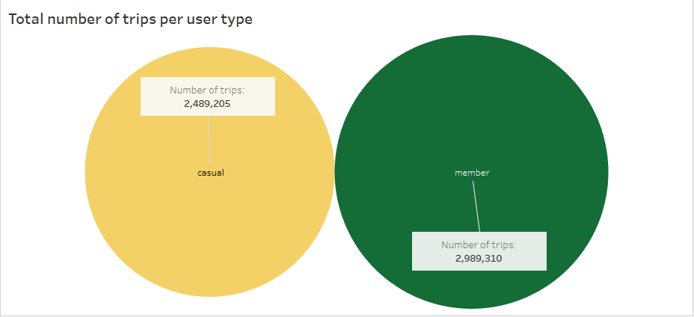
Observation Casual riders vs Annual members
We noticed that casual riders rode Cyclistic bikes much more than annual members
This could be a good reason for targeting casual riders

Slide 10
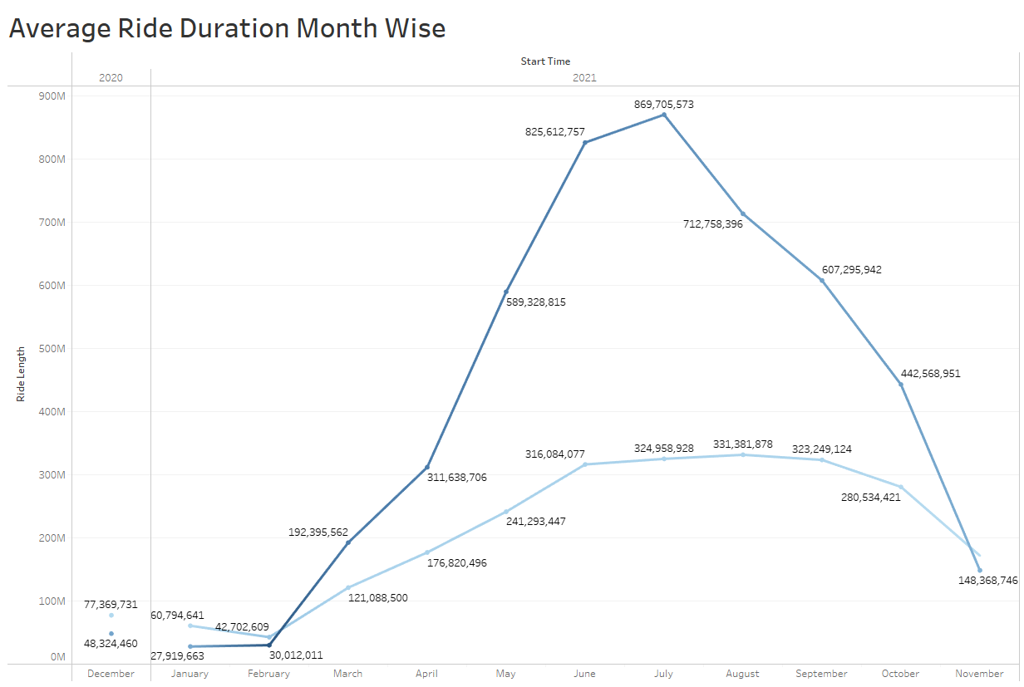
Observation Seasonal riders
It was also noticed that the number of rides by casual riders picks up around April peaking in July and remains high until September
We believe that casual riders should be targeted during this period

Slide 11
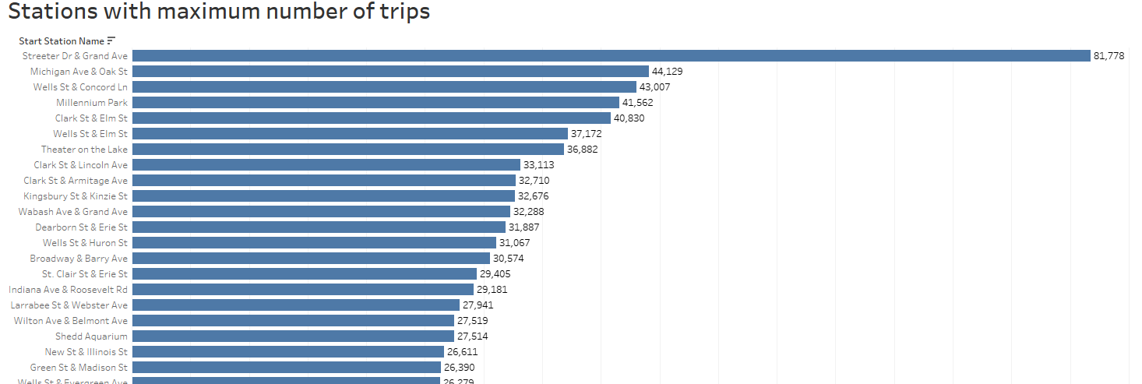
Observation Hotspots
We have identified some stations as being hotspot for casual riders
We believe, campaigns such as road show running in these location will have better chance of attracting casual riders to subscribe to annual membership

Slide 12
Observation Subscription tiering
As per Harvard Business Review website, it has been proven that people are more inclined towards a monthly membership than annual membership
Our recommendation is we should introduce a monthly or periodical membership tier

Slide 13
Recommendations
As shown in previous slides, our recommendations are:
Campaigns targeting casual riders should be run as it may give a boost in annual members
Campaigns should be run during April to September period as it will reach a greater number of casual riders and non-members of Cyclistic
Cyclistic must target below locations to have a better chance of reaching out to casual riders and non-members
Introduction of monthly or periodical membership tier

